Slide 1

SMART SENTIMENTAL ANALYSIS ON YOUTUBE COMMENTS
By:
P Harsha Vardhini (217Z1A6744)
T Venkata Naga Teja (217Z1A6757)
G Karthik Reddy (217Z1A6722)

Slide 2

OUTLINE
Abstract
Introduction
Requirement Specification
Design Architecture
Modules
Conclusion
Proposed System
Existing system
Result

Slide 3


ABSTRACT
Aiming to explore the emotional tones expressed by user in response to YouTube video content.
Fetches Comments of a YouTube video and give analysis in real-time.
Efficiently understands emotion even from emojis.

Slide 4

INTRODUCTION
Sentiment analysis, also known as opinion mining, used to determine the emotional tone behind a body of text.
YouTube comments are a rich source of feedback for content creators, advertisers, and researchers.
Analyzing the sentiment of these comments can help identify trends, understand audience engagement.

Slide 5

EXISTING SYSTEM
Redundancy
Performs Analysis on Video Views, Likes, Subscribers
Can’t Fetch Comments
Ranks the Channel position in region
Emojis are not analyzed
Visualization
Reports aren’t Downloadable

Slide 6






Proposed System
Fetches Comments in real-time
Smart Comment Filtering
Download able Report
YouTube Sentimental Analysis
Comprehends Emojis
Visualization
User friendly Interface

Slide 7
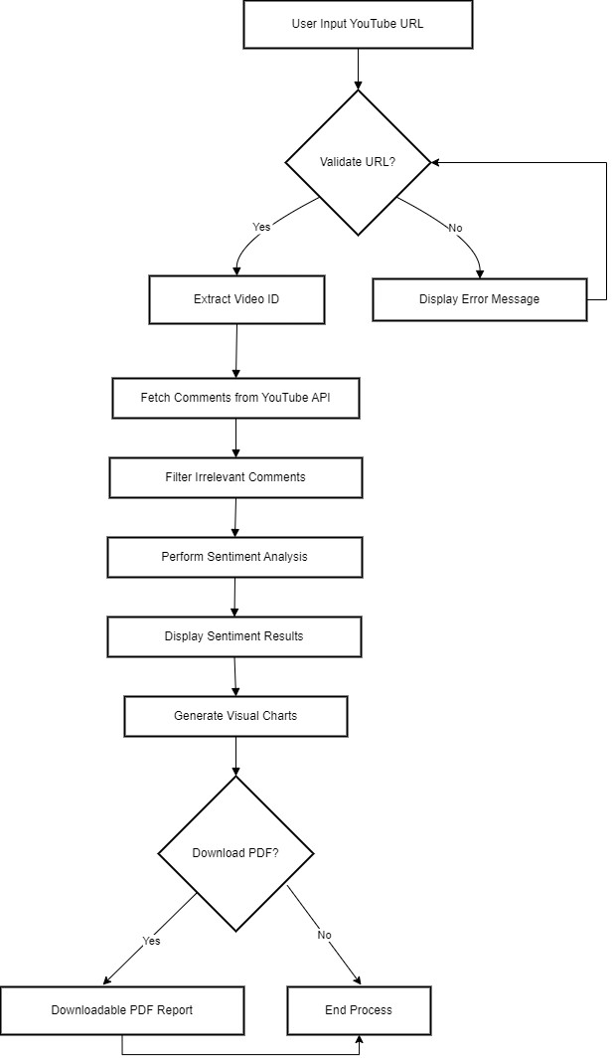
FLOW CHART

Slide 8
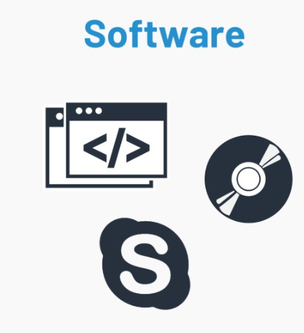
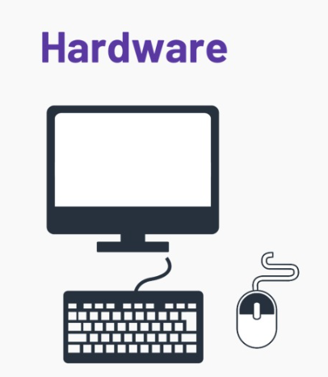


Required specifications
7
Software Specifications
Operating System: Windows, macOS, or Linux
Python: Python 3.6 or Higher
Python Packages: Flask, google-client-python-api, re,vader sentiment.
Hardware specifications
CPU: Modern multi-core processor
RAM: Atleast 4GB (8GB Recommended)
Network:Good Internet connection to access YouTube API

Slide 9
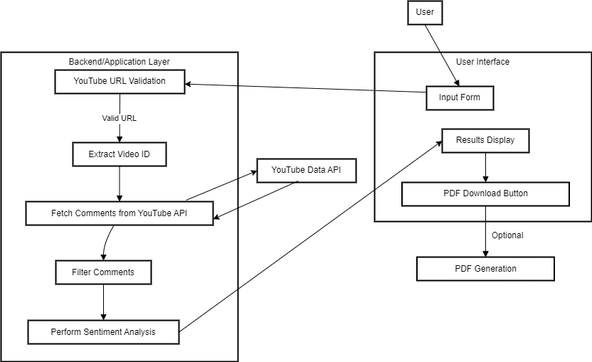
System architecture

Slide 10

MODULES
Flask
Google api client
Emoji
Regular expression
Vader Sentiment

Slide 11
MODULES
Vader sentiment: It stands forValence Aware Dictionary and Sentiment Reasoner .It breaks down text into individual words, assigns scores, and calculates the overall sentiment score.
Flask : This manages the frontend and backend process, it integrates with the YouTube API and helps in displaying the results.
Emoji : This module helps in detecting and converting the emojis into text ,it also help to find the sentiment of a comment .
Re module: The re stand for Regular expression ,This allows us to find patterns and substring form a given text. Using this we have extracted the video ID from URL.
Google Api Client : This module helps in connecting with the applications like YouTube ,Drive, Gmail etc Via APIs. We used this module to fetch the comments from the YouTube.
Flask
Google api client
Vader Sentiment
Regular expression
Emoji
OUTPUT

Slide 12
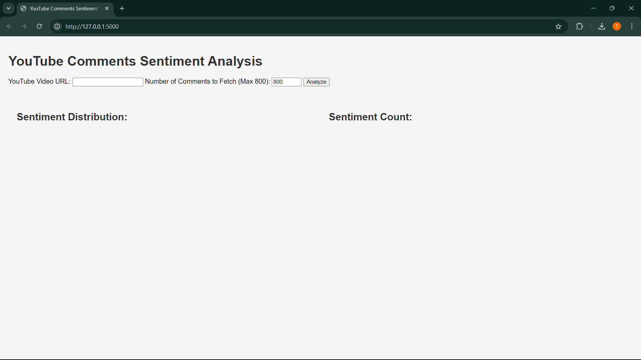
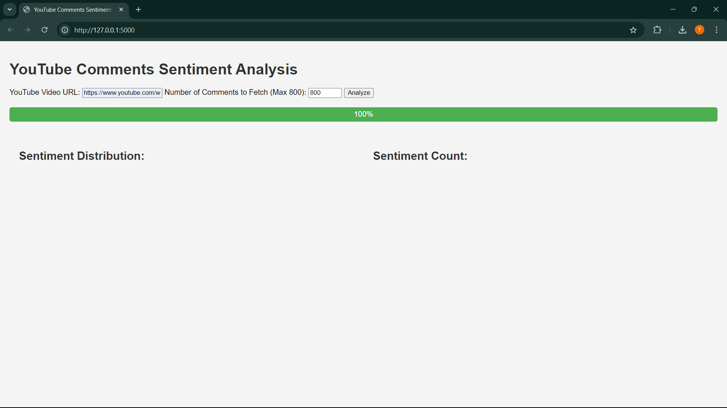
RESULTS
Main page where user needs to enter url
After entering url and clicking analyze

Slide 13
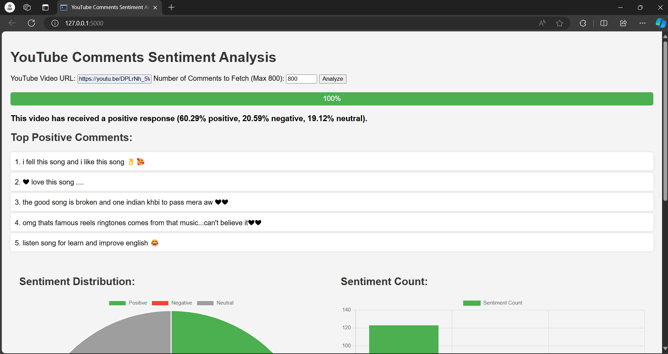
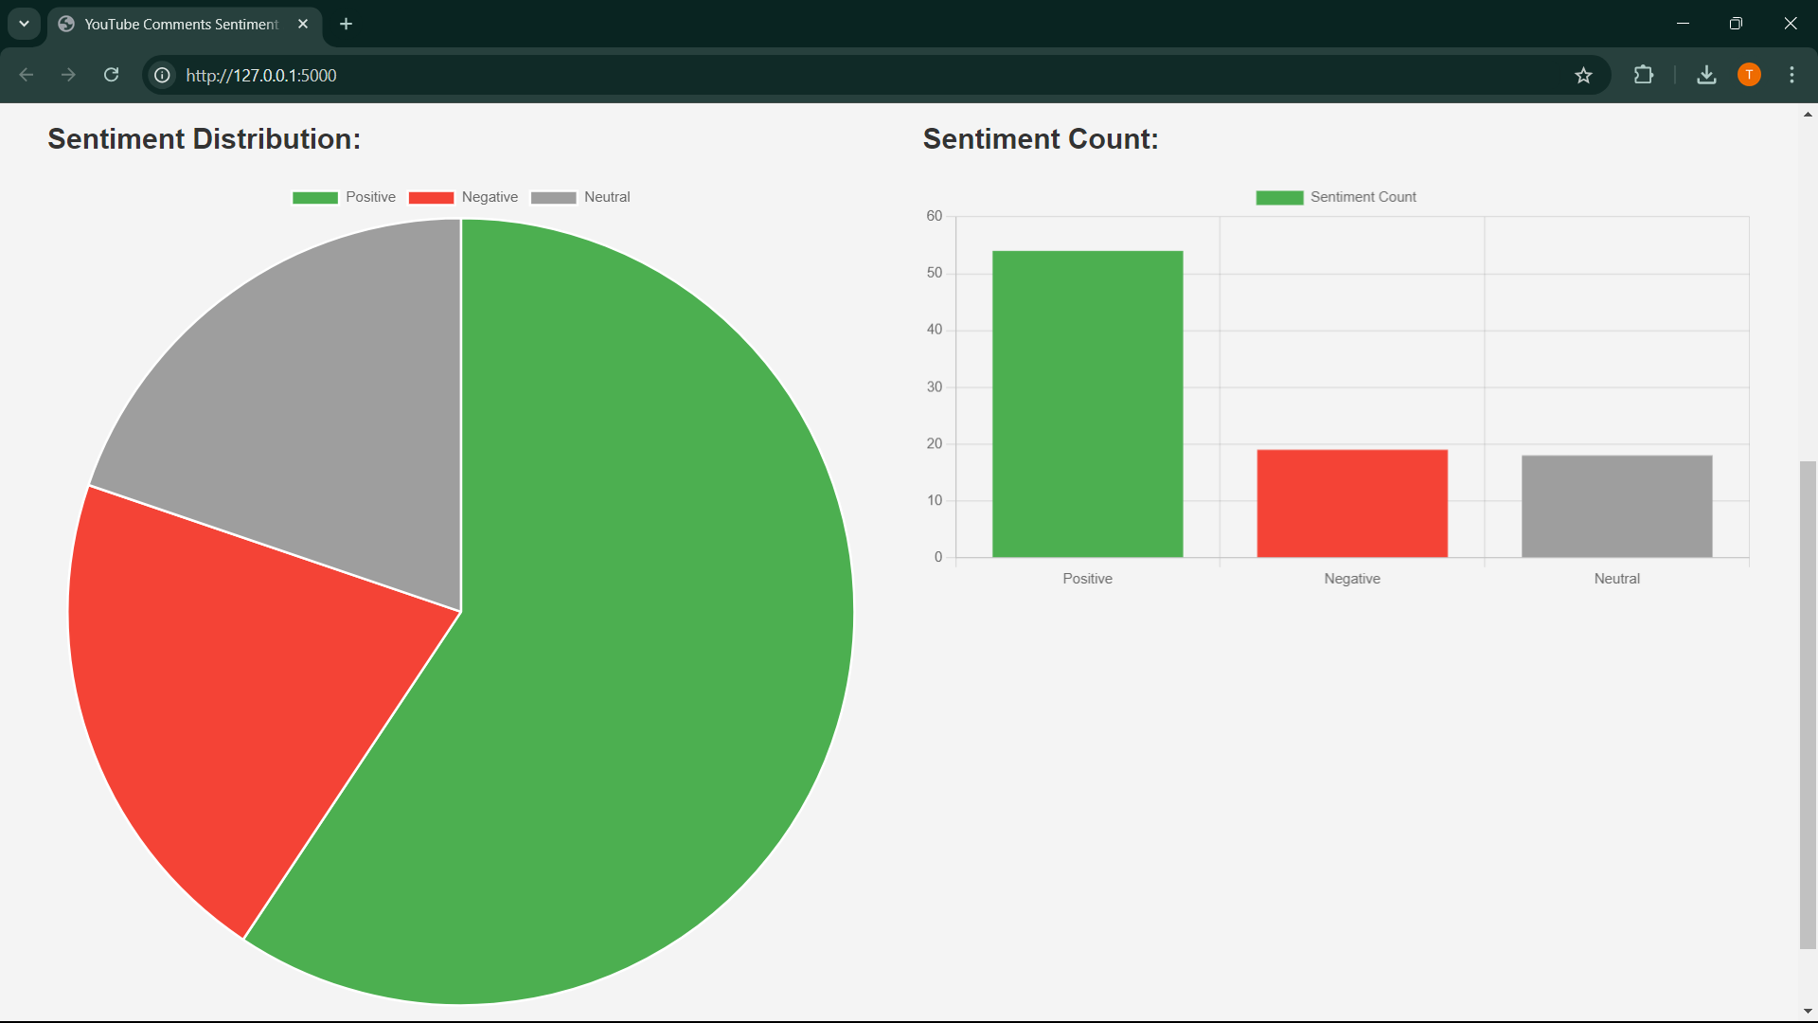

RESULTS
After Fetching the comments & producing results
At the bottom we have a download pdf button

Slide 14

Conclusion
Sentimental Analysis on YouTube Comments helps the Content creator to grow faster.
Makes the YouTube community peaceful.
Encourages Creators to produce content on Audience interest.
Additionally our system provides the extra feature to download the report in pdf format.

Slide 15

Brita Tamm
502-555-0152
brita@firstupconsultants.com
www.firstupconsultants.com

